Slide 1
Nervous tissue:
Is a tissue that are specialized for receiving different types of stimuli (e.g. mechanical , thermal and chemical and transducting them into nerve impulses then may be conducted to nerve centers .
Cells of nervous tissue:
The cells of nervous system are classified into two categories; neurons and nuroglia

Slide 2
Neurons:
The cells responsible for reception and transmition of nerve impulse to and from CNS are the neurons .
Structure of neurons :
Most neurons are composed of three distinct parts cell body , multiple dendrites and single axon.
The cell body of neuron also called the perikaryon
or soma which contains nucleus and perinuclar cytoplasm. Its exhibit different sizes and shapes, it may be spherical
Dendrites : are projecting from the cell body , they are process specialized for receiving stimuli from sensory cells to the soma
Axon : is a single process from each neuron and in the end the axon is branched

Slide 3
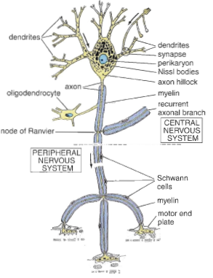

Slide 4
Neural cell body components :
The nucleus is large, spherical to oval and centrally located. the cytoplasm has abundant RER cistern and poly ribosomes and are called nissl bodies which are visible with light microscope and have ability to produce the Ach , nissl bodies are absent at the axon , also has SER which extend into the dendrites and axon . The Golgi complex is present near the nucleus to packaging the neurotransmitters substances, also mitochondria see scatter in the cytoplasm of neuron.

Slide 5
Types of neurons:
The neurons are classified morphologically into three major types according to their shape and the arrangement of their processes:
1 – Unipolar neuron: possesses one cell process ,true unipolar neurons are rare in vertebrates.
2 -Bipolar neurons : possess two processes from the soma , single dendrite and single axon ,Bipolar neurons are located in the vestibular and cochlear ganglia and in the olfactory epithelium of nasal cavity .
3 –Pseudo unipolar neurons: posses only one process from the soma but this process branches later into peripheral branches and central branch ,each branches is morphologically axonal , these type of neurons present in cranial nerves ganglia .
4 – Multipolar neurons.
The most common type, posses various arrangement of multiple dendrites from the soma and single axon

Slide 6
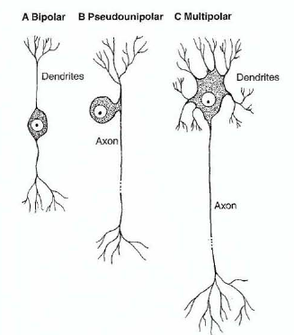

Slide 7
According to the function the neurons can be classified into:
1 –Sensory (afferent ) neurons , receive sensory impulse at their dendrites terminals and conduct impulses to CNS .
2 – Motor ( efferent ) neurons originate in CNS and conduct their impulse to muscles ,glands and other neurons .
3 – Inter neurons : located completely in CNS it form interconnection network of neuronal circuits between sensory and motor neurons

Slide 8
Neuroglial cells :
The function of these cells is the metabolic and mechanical support and protection of neurons it include astrocyte , oligodendrocyte , microglia and ependymal cells ,Schwann cells .
Nerve fibers ( Axon ) :
Sheath covering of the nerve fibers is myelin sheath , Schwann sheath .
Myelin sheath is forming whitish fatty covering formed of thin layers of protein and lipid, the sheath is interrupted at node of ranvier, this sheath is formed by Schwann cells which elongates and enveloped the axon at myelin segment.
Glial cells :
Oligodendrocytes: these cells have processes that wrap around axons, producing myelin sheath around neurons in the CNS .
Schwann cells : have the same function as oligodendrocytes but are located around axons in peripheral nervous system PNS .
Astrocytes :are star shaped cells with multiple radiating process . Astrocytes bind neurons to capillaries and to the pia mater , astrocytes have supporting function and may repair the damage occur in CNS by forming scar tissue , forming blood brain barrier ,some arstrocytes develop expanded (end feet) linked to the endothelial cells it is believed that transfer molecules and ions from blood to neurons .
Ependymal cell : low columnar epithelial cells lining the ventricles of the brain and central canal of spinal cord some time are ciliated to facilitate the movement of cerebrospinal fluid .
Microglia: small elongated cells with short irregular processes ,its phagocytic cells its derived from bone marrow

Slide 9
Synapses:
The synapses are the sites of impulse transmission between the presynaptic and postsynaptic cells (another neuron , muscle cells or cells of glands )
The impulse transmission at synapses can occur electrically or chemically , electrical type uncommon in mammals occur by movement ions through the gap from one cells to other , chemical type by Ach and Adrenalin .
Ganglia :
Are aggregation of cells bodies of neurons located outside the CNS and surrounded by connective tissue capsule . There are two types of ganglia, sensory and autonomic .
Sensory ganglia: are associated with cranial nerves and spinal nerves .
Autonomic ganglia: sympathetic and parasympathetic multipolar

Slide 10
Nerves
In the peripheral nervous system, the nerve fibers are grouped in bundles to form the nerves. Except for a few very thin nerves made up of unmyelinated fibers, nerves have a whitish, homogeneous, glistening appearance because of their myelin and collagen content.
Nerves have an external fibrous coat of dense connective tissue called epineurium, which also fills the space between the bundles of nerve fibers. Each bundle is surrounded by the perineurium, a sleeve formed by layers of flattened epithelium like cells. The cells of each layer of the perineurial sleeve are joined at their edges by tight junctions, an arrangement that makes the perineurium a barrier to the passage of most macromolecules and has the important function of protecting the nerve fibers from aggression. Within the perineurial sheath run the Schwann cell-sheathed axons and their enveloping connective tissue, the endoneurium .The endoneurium consists of a thin layer of reticular fibers, produced by Schwann cells.

Slide 11
